Slide 1

V-Model
The V-Model is a software development life cycle (SDLC) model that provides a systematic and visual representation of the software development process.
It is based on the idea of a “V” shape, with the two legs of the “V” representing as the Verification and Validation model.
The development of each step is directly associated with the testing phase. The next phase starts only after completion of the previous phase i.e., for each development activity, there is a testing activity corresponding to it.

Slide 2
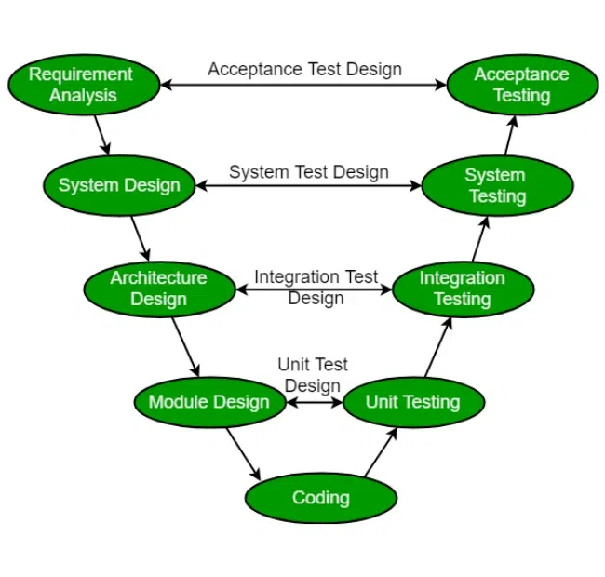
SDLC V-Model

Slide 3
The following illustration depicts the different phases in a V-Model of the SDLC
Verification phase
Business Requirement Analysis:
This is the first step of the designation of the development cycle where product requirement needs to be cured from the customer’s perspective. in these phases include proper communication with the customer to understand the requirements of the customers. these are the very important activities that need to be handled properly, as most of the time customers do not know exactly what they want, and they are not sure about it at that time then we use an acceptance test design planning which is done at the time of business requirement it will be used as an input for acceptance testing.
System Design:
Design of the system will start when the overall we are clear with the product requirements, and then need to design the system completely. This understanding will be at the beginning of complete under the product development process. these will be beneficial for the future execution of test cases.

Slide 4
CONT….
Architectural Design:
In this stage, architectural specifications are comprehended and designed. Usually, several technical approaches are put out, and the ultimate choice is made after considering both the technical and financial viability. The system architecture is further divided into modules that each handle a distinct function. Another name for this is High-Level Design (HLD).
At this point, the exchange of data and communication between the internal modules and external systems are well understood and defined. During this phase, integration tests can be created and documented using the information provided.
Module Design:
This phase, known as Low-Level Design (LLD), specifies the comprehensive internal design for every system module. Compatibility between the design and other external systems as well as other modules in the system architecture is crucial. Unit tests are a crucial component of any development process since they assist in identifying and eradicating the majority of mistakes and flaws at an early stage. Based on the internal module designs, these unit tests may now be created.

Slide 5
CONT…
Coding Phase:
The Coding step involves writing the code for the system modules that were created during the Design phase. The system and architectural requirements are used to determine which programming language is most appropriate.
The coding standards and principles are followed when performing the coding. Before the final build is checked into the repository, the code undergoes many code reviews and is optimized for optimal performance.

Slide 6
Validation phases
So, V-Model contains Verification phases on one side of the Validation phases on the other side. The verification and Validation phases are joined by the coding phase in a V-shape. Thus, it is called V-Model. There are several Validation phases in the V-Model:
Unit Testing:
Unit Test Plans are developed during the module design phase. These Unit Test Plans are executed to eliminate bugs in code or unit level.
Integration testing:
After completion of unit testing Integration testing is performed. In integration testing, the modules are integrated and the system is tested. Integration testing is performed in the Architecture design phase. This test verifies the communication of modules among themselves.
System Testing:
System testing tests the complete application with its functionality, inter-dependency, and communication. It tests the functional and non-functional requirements of the developed application.

Slide 7
CONT…
User Acceptance Testing (UAT):
UAT is performed in a user environment that resembles the production environment. UAT verifies that the delivered system meets the user’s requirement and the system is ready for use in the real world.
Design Phase:
Requirement Analysis: This phase contains detailed communication with the customer to understand their requirements and expectations. This stage is known as Requirement Gathering.
System Design: This phase contains the system design and the complete hardware and communication setup for developing the product.
Architectural Design: System design is broken down further into modules taking up different functionalities. The data transfer and communication between the internal modules and with the outside world (other systems) is clearly understood.
Module Design: In this phase, the system breaks down into small modules. The detailed design of modules is specified, also known as Low-Level Design (LLD).

Slide 8
CONT…
Testing Phases:
Unit Testing: Unit Test Plans are developed during the module design phase. These Unit Test Plans are executed to eliminate bugs at the code or unit level.
Integration testing: After completion of unit testing Integration testing is performed. In integration testing, the modules are integrated, and the system is tested. Integration testing is performed in the Architecture design phase. This test verifies the communication of modules among themselves.
System Testing: System testing tests the complete application with its functionality, interdependency, and communication. It tests the functional and non-functional requirements of the developed application.
User Acceptance Testing (UAT): UAT is performed in a user environment that resembles the production environment. UAT verifies that the delivered system meets the user’s requirement and the system is ready for use in the real world.

Slide 9
Principles of V-Model
Large to Small: In V-Model, testing is done in a hierarchical perspective, for example, requirements identified by the project team, creating High-Level Design, and Detailed Design phases of the project. As each of these phases is completed the requirements, they are defining become more and more refined and detailed.
Data/Process Integrity: This principle states that the successful design of any project requires the incorporation and cohesion of both data and processes. Process elements must be identified at every requirement.
Scalability: This principle states that the V-Model concept has the flexibility to accommodate any IT project irrespective of its size, complexity, or duration.
Cross Referencing: A direct correlation between requirements and corresponding testing activity is known as cross-referencing.

Slide 10
Importance of V-Model
1. Early Defect Identification
By incorporating verification and validation tasks into every stage of the development process, the V-Model encourages early testing. This lowers the cost and effort needed to remedy problems later in the development lifecycle by assisting in the early detection and resolution of faults.
2. determining the Phases of Development and Testing
The V-Model contains a testing phase that corresponds to each stage of the development process. By ensuring that testing and development processes are clearly mapped out, this clear mapping promotes a methodical and orderly approach to software engineering.
4. Improves Cooperation
At every level, the V-Model promotes cooperation between the testing and development teams. Through this collaboration, project requirements, design choices, and testing methodologies are better understood, which improves the effectiveness and efficiency of the development process.
5. Improved Quality Assurance
Overall quality assurance is enhanced by the V-Model, which incorporates testing operations at every level. Before the program reaches the final deployment stage, it makes sure that it satisfies the requirements and goes through a strict validation and verification process.

Slide 11
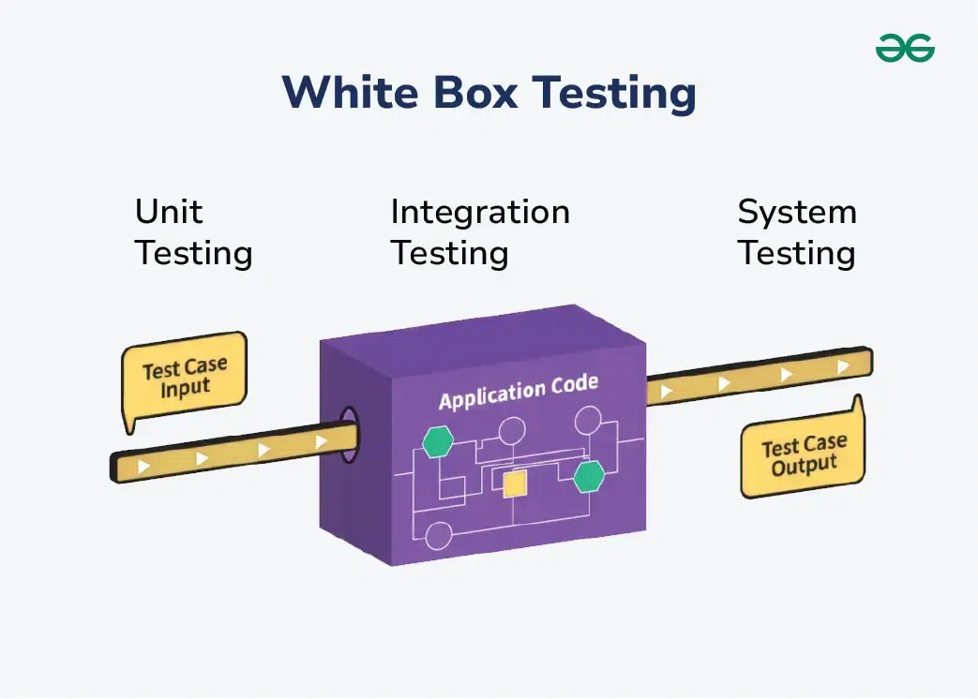
White Box Testing
White box testing is a software testing technique that involves testing the internal structure and workings of a software application. The tester has access to the source code and uses this knowledge to design test cases that can verify the correctness of the software at the code level.
White box testing is also known as structural testing or code-based testing, and it is used to test the software’s internal logic, flow, and structure. The tester creates test cases to examine the code paths and logic flows to ensure they meet the specified requirements.

Slide 12
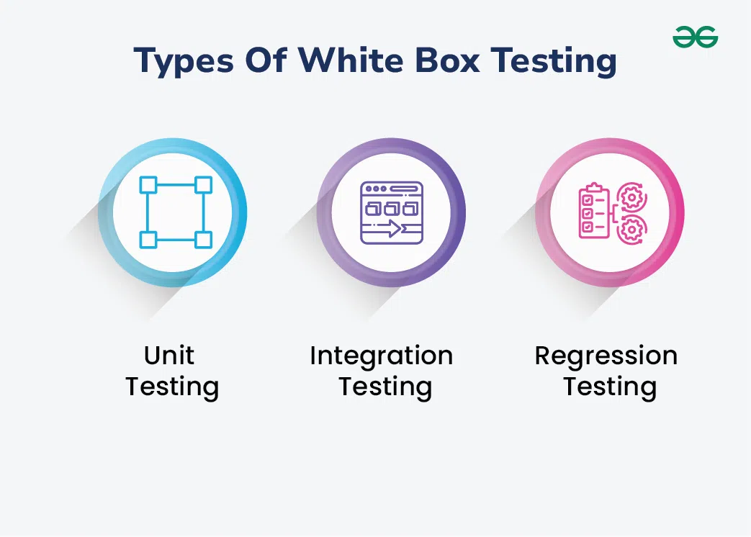
Types Of White Box Testing
Unit Testing
Checks if each part or function of the application works correctly.
Ensures the application meets design requirements during development.
Integration Testing
Examines how different parts of the application work together.
Done after unit testing to make sure components work well both alone and together.
Regression Testing
Verifies that changes or updates don’t break existing functionality.
Ensures the application still passes all existing tests after updates.

Slide 13
Process Of White Box Testing
1.Input: Requirements, Functional specifications, design documents, source code.
Processing: Performing risk analysis to guide through the entire process.
Proper test planning: Designing test cases to cover the entire code. Execute rinse-repeat until error-free software is reached. Also, the results are communicated.
Output: Preparing the final report of the entire testing process.
White Testing is performed in 2 Steps
Tester should understand the code well
Tester should write some code for test cases and execute them

Slide 14
Features of White Box Testing
1. Code coverage analysis: White box testing helps to analyze the code coverage of an application, which helps to identify the areas of the code that are not being tested.
2. Access to the source code: White box testing requires access to the application’s source code, which makes it possible to test individual functions, methods, and modules.
3. Knowledge of programming languages: Testers performing white box testing must have knowledge of programming languages like Java, C++, Python, and PHP to understand the code structure and write tests
4. Identifying logical errors: White box testing helps to identify logical errors in the code, such as infinite loops or incorrect conditional statements.
5. Integration testing: White box testing is useful for integration testing, as it allows testers to verify that the different components of an application are working together as expected.
6. Unit testing: White box testing is also used for unit testing, which involves testing individual units of code to ensure that they are working correctly.

Slide 15
Conclusion
White box testing is primarily used in traditional software development, while model testing is specific to machine learning models.
White box testing focuses on the internal workings of code, whereas model testing focuses on the performance and generalizability of a predictive model.

